Slide 1
Autores
http://www.hbs.edu/faculty/Pages/profile.aspx?facId=6576
http://www.hbs.edu/faculty/Pages/profile.aspx?facId=9917

Slide 2
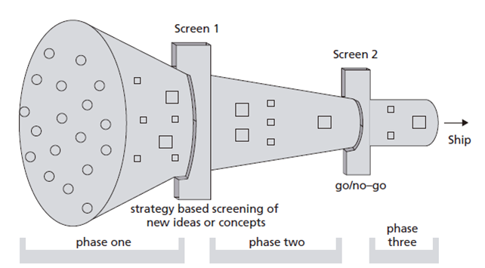

Slide 3
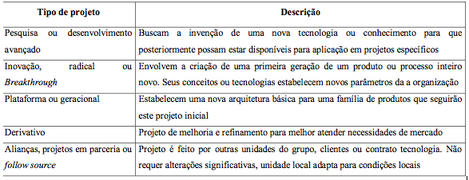

Slide 4
Chapter 10 Prototype/Test Cycles
Overview
The Traditional Approach to Prototyping
Prototyping: A Managerial Perspective
Matching Prototyping and Development Project Requirements
Study Questions
Cases: Sony Corporation: Workstation Division

Slide 5
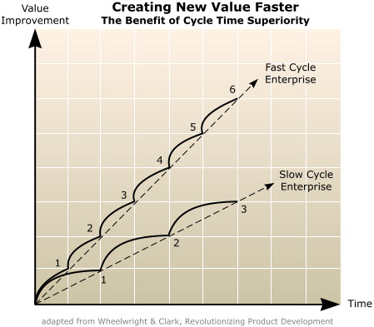

Slide 6
Core argument
The author empathizes the fact that the traditional P & D process is unable to proportionate rich opportunities exploration process, and it is in fact made by outdated researches centers.
An improvement to innovative process can lead companies to achieve goals and dominate markets.

Slide 7
Recommendations
Managers participation Like (Kim and Willemon, 2002) the authors attempt to the fact that managers should be more present in every step of the process, not just only at the end evaluating the final prototype.

Slide 8
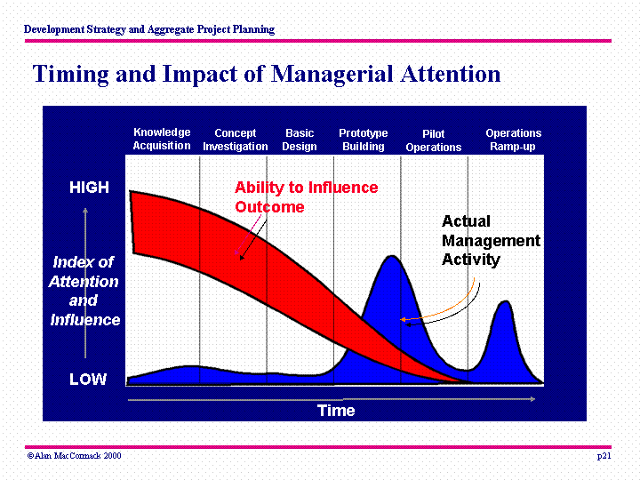

Slide 9
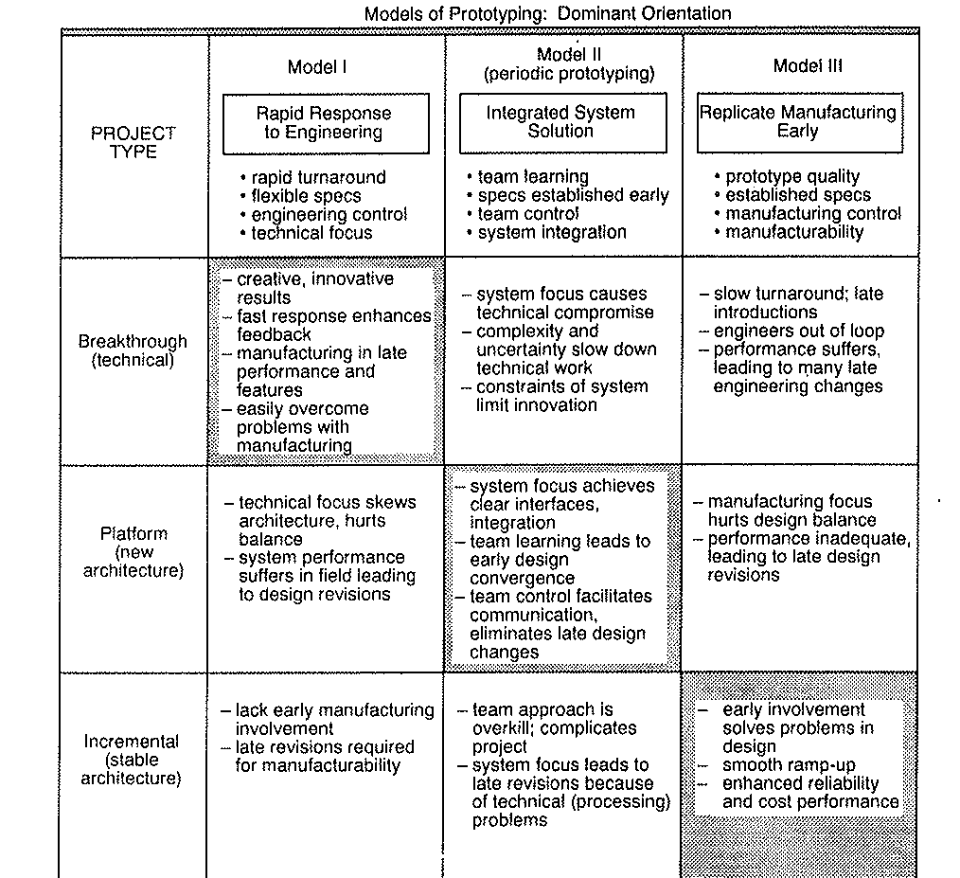

Slide 10
O que é o ciclo de Design-Build-Test em prototipagem?
O que a abordagem convencional?
Problemas com a aboradgem convencional?
O que é a abordagem periodica de prototipagem?
Como selecionar diferentes abordagens de prototipagem? Por que a Periodica não é adequada para Avião de garnde porte?

